Slide 1

PROPOSED DIGITAL SOLUTION FOR FARMERS
Empowering Farmers Through Technology

Slide 2
Table of contents
Introduction
Proposed Digital Solution
01
04
02
Survey Overview
05
Implementation Plan
Survey Insights
03
Conclusion
06

Slide 3

01
Introduction

Slide 4

Introduction
The agricultural sector, especially smallholder farmers, faces numerous challenges that hinder productivity and sustainability. Therefore, there is a need to digitalize agriculture to streamline farmers' affairs and enhance productivity.

Slide 5
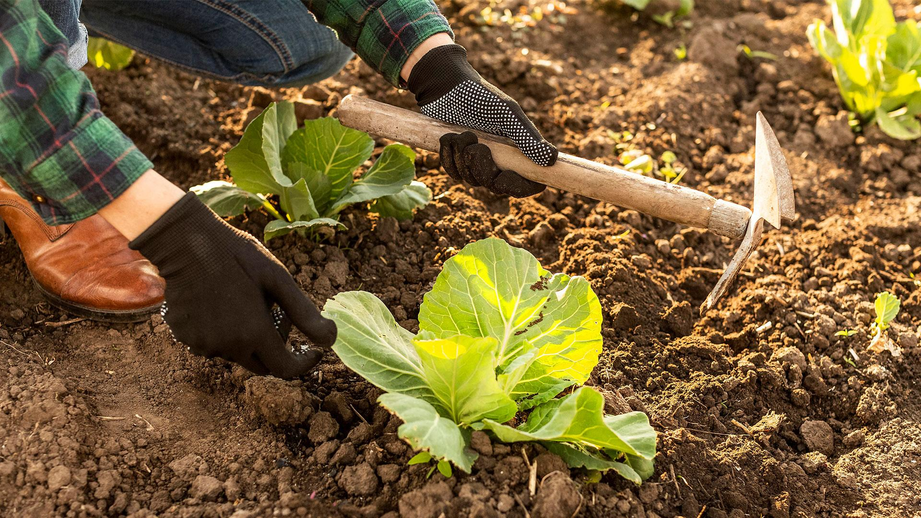
02
Survey Overview

Slide 6
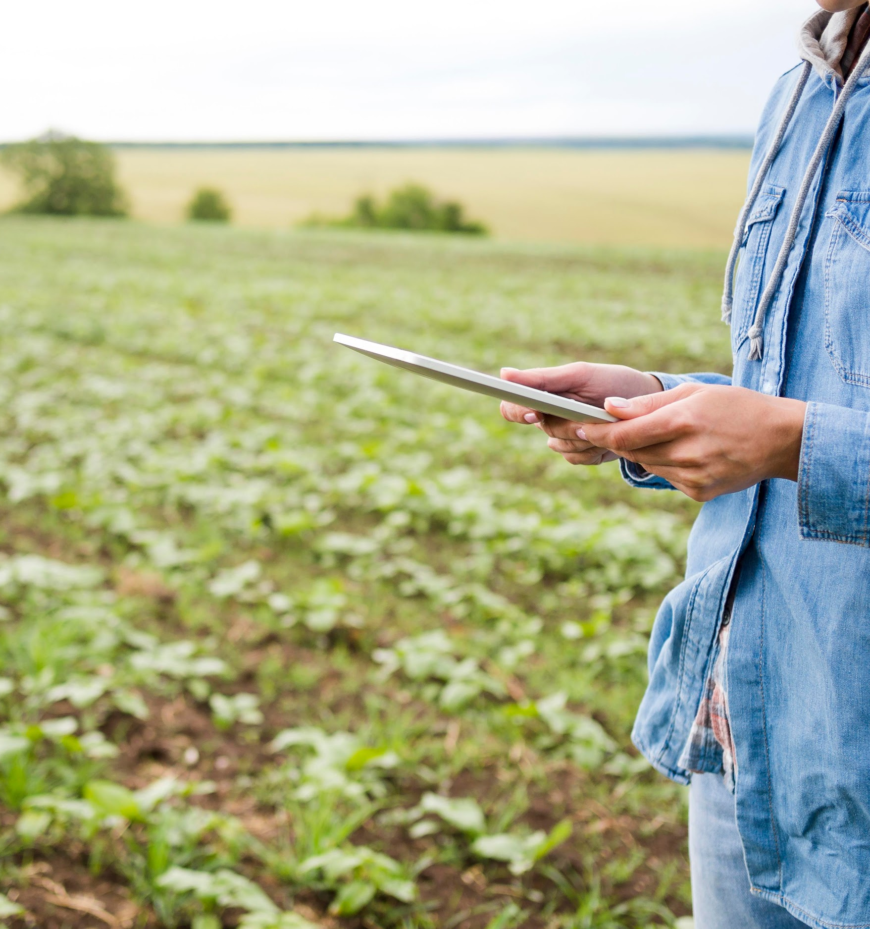
Sample Overview
To better understand these challenges, a comprehensive survey was conducted among smallholder farmers. The survey aimed to have a clearer understanding of the challenges encountered by farmers which included to :
Identify the demographic and economic profiles of farmers
Understand the levels of education and language proficiency
Assess their level of income and how well they are willing to embrace technology
Determine the most critical input needs for farming

Slide 7
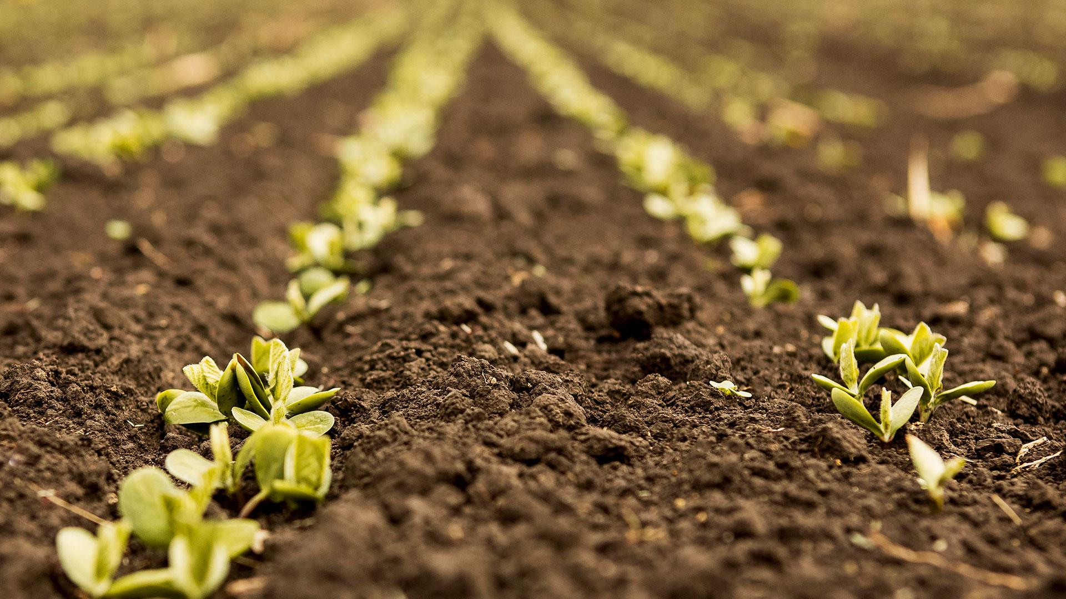
03
Survey Insights

Slide 8
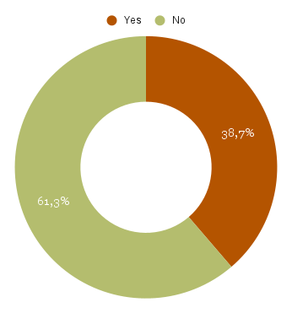
Demographics
Gender
Age range
20-29 years
10%
63%
Men
30-35 years
24%
36-39 years
10%
Total number of Men who participated
English Proficiency
37%
Women
Total number of Women who participated
40-49 years
30%
50-59 years
22%
Above 60
4%
Out of the farmers, only 61% of them can communicate in English while 39% of them cannot.

Slide 9
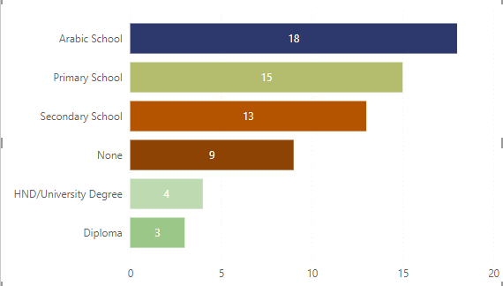
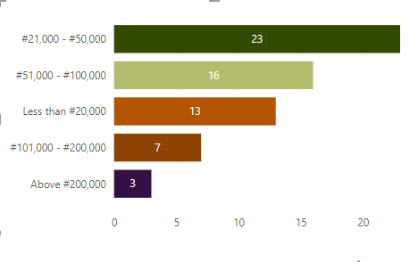
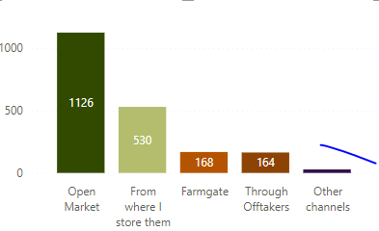
Economic Profile of Farmers
Level of Education
Avg Monthly Income
Avg Monthly Income
Where products are sold

Slide 10




Critically Needed Inputs of Farmers
38%
25%
20%
Needs Fertilizers
Needs Seed
Needs Machinery
7%
10%
Gap Extension
Others

Slide 11
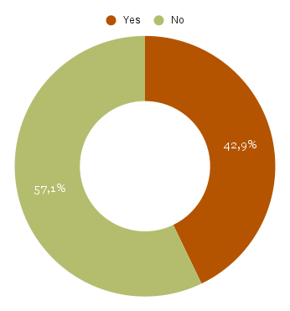
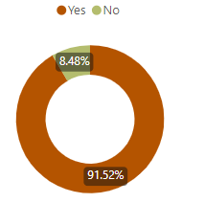

The use of Mobile devices
Only 57% of farmers use mobile phone while 43% of farmers don’t use
92% of farmers will be willing to embrace the use of mobile devices to get more customers
More than 50% found the experience of using mobile phones enjoyable therefore a digital solution for farmers will make a huge difference.

Slide 12
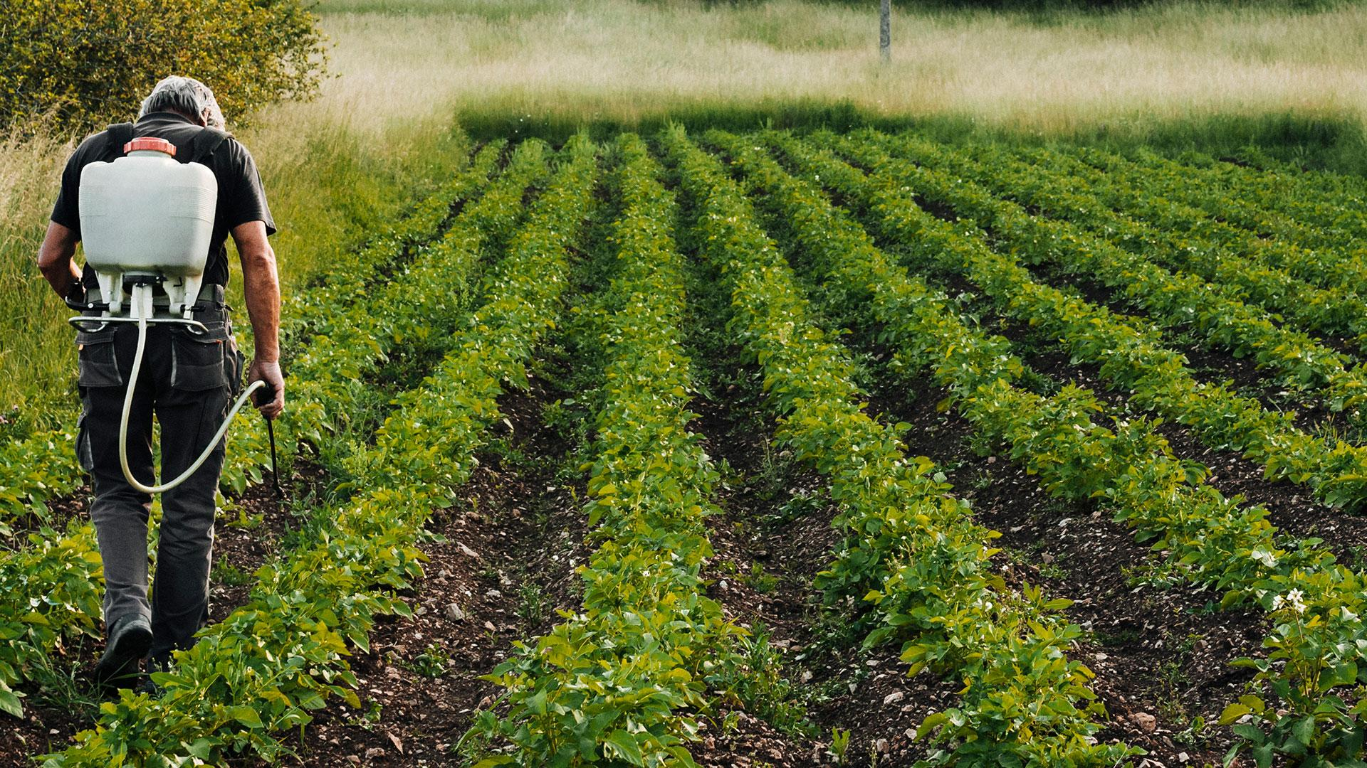
Proposed Digital Solutions
04

Slide 13

Digital Market Place Platform
This platform connects Farmers to more markets, farmers can also list and sell their products directly to buyers.
Platform Features
Platform Benefits
Product Listing
Increase Market Access
Secure Payment Gateway
Fair Pricing for Products
Delivery Coordination
Reduced Need for Middlemen

Slide 14
Access to Farming Inputs
Bulk Purchasing of seeds, fertilizers and renting of machinery
Cost saving through bulk purchases and economies of scale reduce costs, making inputs more affordable.
Online Ordering
With timely access to quality inputs, farmers receive necessary resources when needed, leading to better crop yields.
Home Delivery
It helps improve crop yield, and access to high-quality inputs ensures better productivity and profitability.
This is a solution that ensures farmers receive the necessary inputs needed to strive, inputs such as seeds, fertilizers, and machinery.

Slide 15
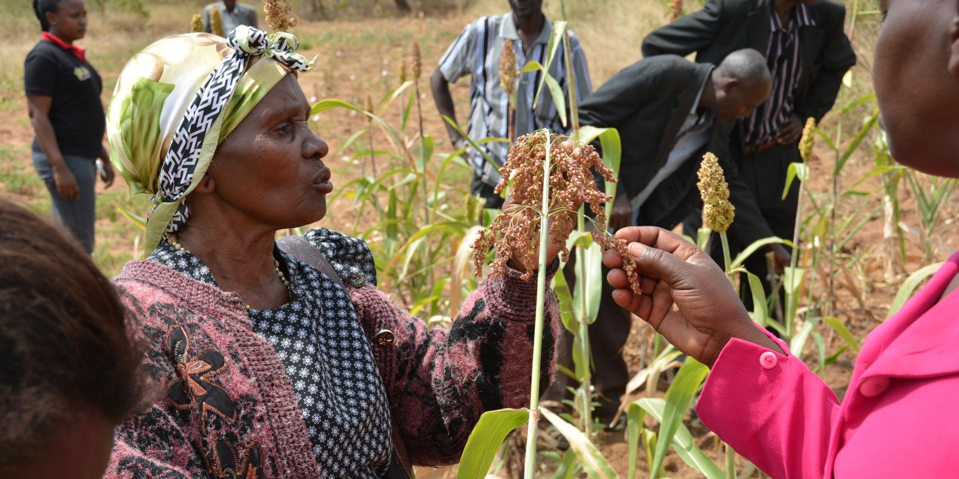
Community Forum and Support Network
Discussion Forums
This platform helps to Foster Collaboration and Support, farmers connect, share experiences, and seek advice here.
This forum will enhance knowledge sharing and farmers can learn from each other's experiences and solutions.
Emotional and practical support provides a sense of community and a support network for farmers.
Peer to Peer Support
Experts Q & A Session
Experts orientation goes a long way to educating ans supporting farmers.

Slide 16
Educational and Training Resources
Multilingual Video Tutorials
Webinars and Workshops
Interactive Training Modules
Farmers can learn new and efficient farming methods in their local languages to aid improve farming techniques
Farmers learn about and implement environmentally friendly practices which would result in an increased adoption of sustainable practices
Farmers would have access to better techniques and knowledge leading to increased farm output.

Slide 17
Partnerships and Collaboration
Collaborations with Agricultural Organizations
Partnerships with Financial Institutions
Financial institutions can offer loans and financial products tailored to farmers' needs. This partnership can unlock limitless opportunities and success.
Partnerships will provide farmers with more tools and resources.
Engagement with Government Agencies
Collaborations with Agric-Tech Innovators
Collaborating with Agri-Tech innovators to help farmers thrive by developing solutions with the use of AI, for instance, weather prediction systems and machine learning models for forecasting future occurrences.
Collaboration with government agencies can lead to supportive policies and initiatives.

Slide 18
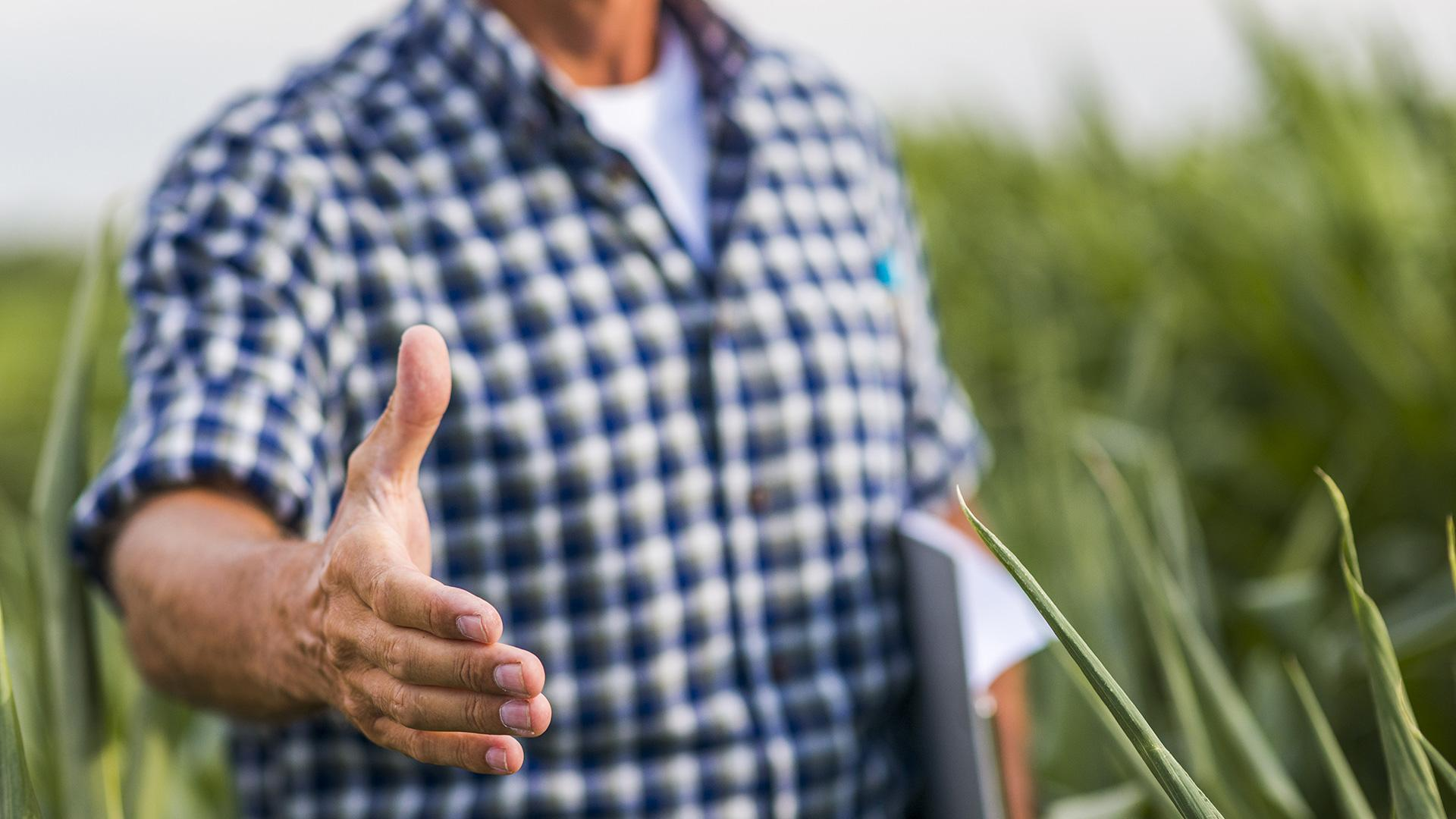
05
Implementation Plan
Roadmap to Digitalizing Agriculture

Slide 19
Steps to implement the Proposed Digital Solutions
3-6 months
3-6months
Ongoing
Platform Development
Pilot Testing
Full-Scale Development
Continuous Improvement and Support
2-3 months
Develop the digital marketplace platform, build educational and training resource portals, set up community forums and support networks
Select a pilot group of farmers, train farmers on using the platforms, monitor usage and collect feedback, make necessary adjustments based on feedback
Launch marketing and awareness campaigns, provide training and support to farmers, monitor platform usage and performance, continuously collect feedback and make improvements
Regular platform updates, continuous support programs and regular impact reports

Slide 20

Conclusion
06

Slide 21

"In God we trust. All others must bring data." – W. Edwards Deming.
By harnessing the power of data and technology, we can enhance productivity, promote agricultural prosperity, and ensure sustainable practices and food security for all.

Slide 22
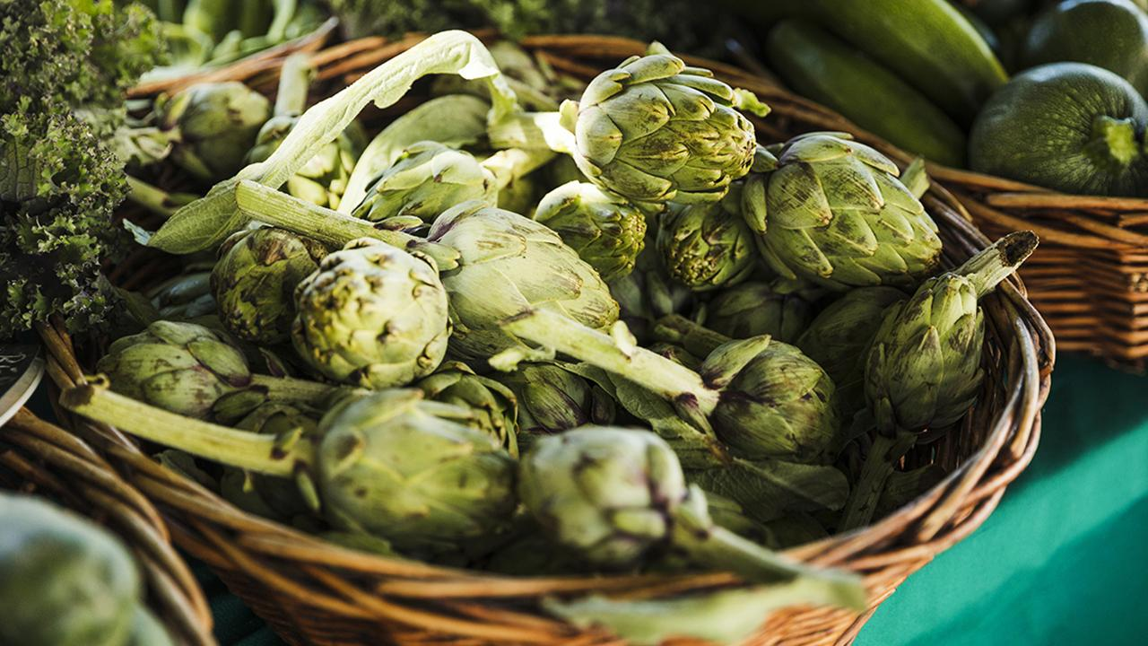
Thank you

